Slide 1
Software Project Management
Chapter 3. Estimation

Slide 2
Wideband Delphi Estimation
The Wideband Delphi estimation method was developed in the 1940s at the Rand Corporation as a forecasting tool.
The Wideband Delphi estimation process is especially useful to a project manager because it produces several important elements of the project plan.
Wideband Delphi works because it requires the entire team to correct one another in a way that helps avoid errors and poor estimation.

Slide 3
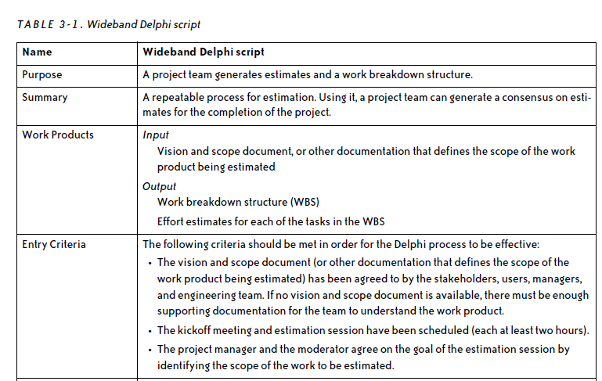
The Delphi Process

Slide 4
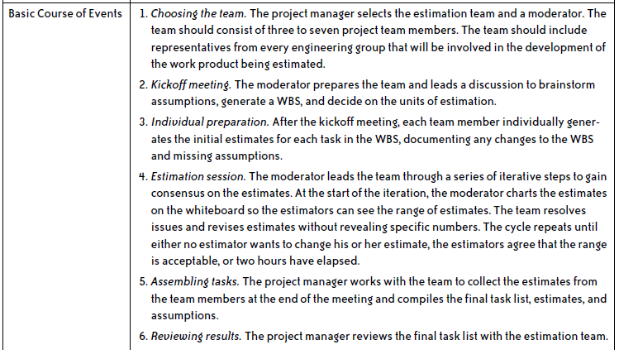

Slide 5
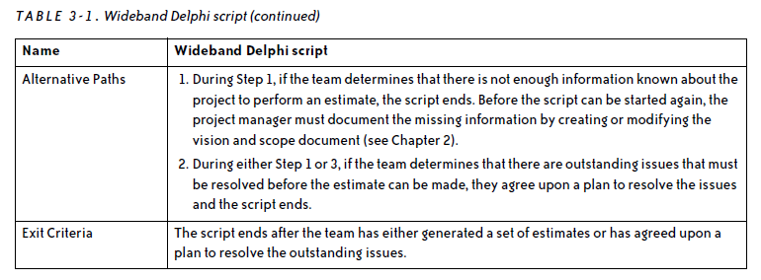

Slide 6
Choosing the team
Picking a qualified team is an important part of generating accurate estimates.
Each team member must be willing to make an effort to estimate each task honestly, and should be comfortable working with the rest of the team.
The project manager should choose the team, and it should include people that she is comfortable working with.

Slide 7
Kickoff meeting
The goal of the kickoff meeting is to prepare the team for the estimation session.
When the kickoff meeting is scheduled, each team member is given the vision and scope document and any other documentation that will help her understand the project she is estimating.
The team members should read all of the material before attending the meeting.

Slide 8
The moderator leads the meeting, which consists of the following activities:
The moderator explains the Wideband Delphi method to any new estimators.
If any team member has not yet read the vision and scope document and supporting documentation, the moderator reviews it with the team.
The moderator reviews the goal of the estimation session with the team, and checks that each team member is sufficiently knowledgeable to contribute.

Slide 9
Continue…
The team discusses the product being developed and brainstorms any assumptions.
The team generates a task list consisting of 10–20 major tasks. These tasks represent the top level of the work breakdown structure.
The team agrees on the units of estimation (days, weeks, pages, etc.).

Slide 10
Individual preparation
After the kickoff meeting, the moderator writes down all of the assumptions and tasks that were generated by the team during the kickoff meeting and distributes them to the estimation team.
Each team member independently generates a set of preparation results.

Slide 11
Continue…
Each team member builds preparation results by first filling in the tasks, and then estimating the effort for each task.
An estimate for each task should be added to the “Tasks to achieve goal” section of the preparation results; the “Time” column should contain the estimate for each task.

Slide 12
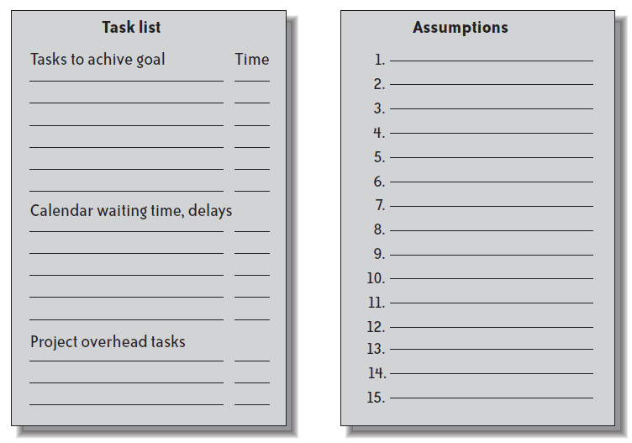

Slide 13
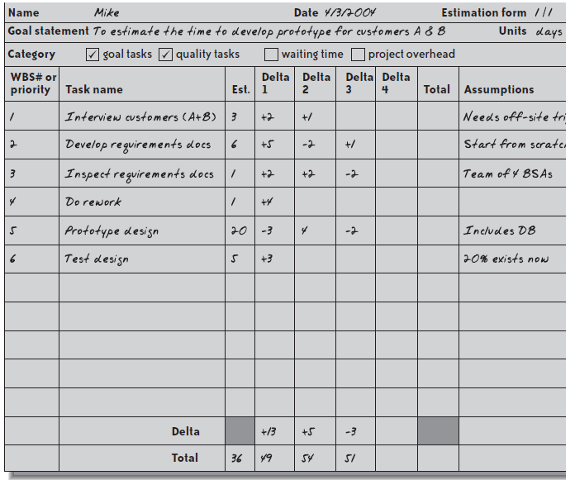

Slide 14
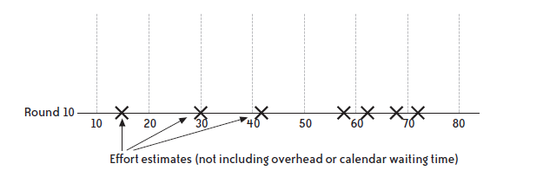

Slide 15
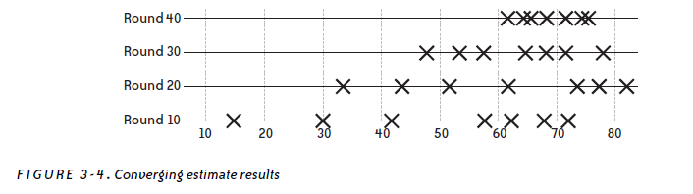

Slide 16
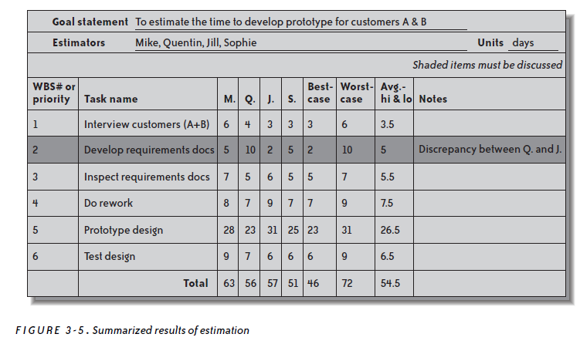

Slide 17
Other Estimation Techniques
Wideband Delphi is not the only technique that can be effective in estimating software tasks. Here are a few popular and effective alternatives.
PROBE
COCOMO II
The Planning Game

